Slide 1
Graph DB
Proof of Concept
Starter Kit
September 28, 2018
KROLL BOND RATING AGENCY, INC

Slide 2
Agenda
Pete
Introduction
SQL
Document
Graph
Installation
Java
File Download
Folder Setup
Command Line
Tour
:play start
:play concepts
:play write-code
:play cypher
:play intro
Pete - continued
Jupyter
Libraries
Query
SQL Example
Whiteboard Exercise
ETL

Slide 3
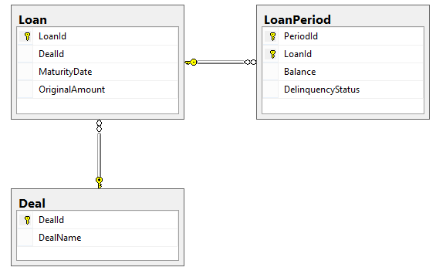
SQL

Slide 4
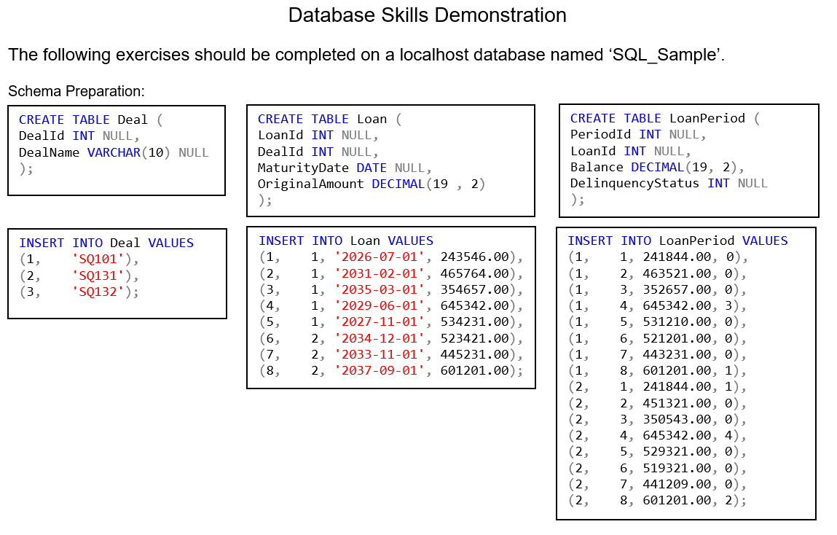
SQL

Slide 5
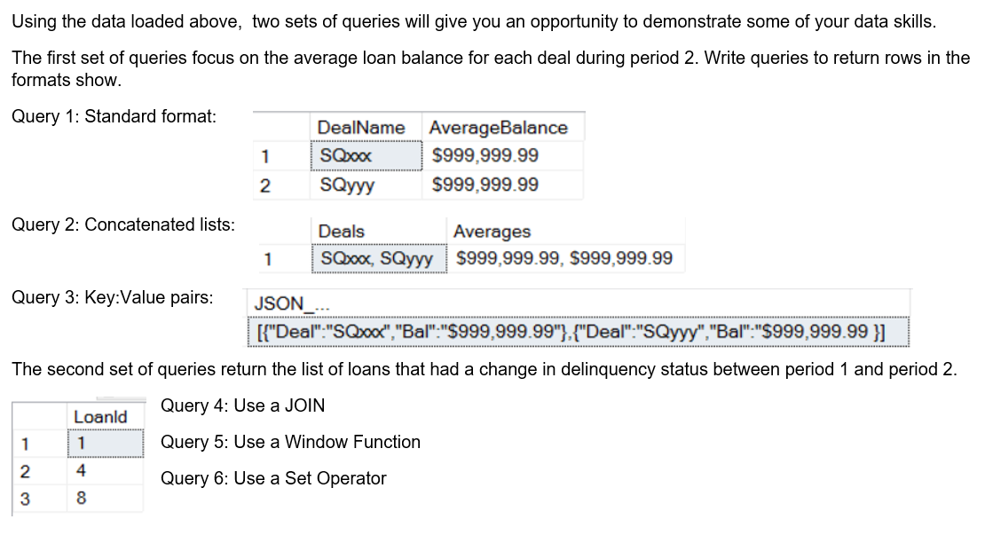
SQL

Slide 6
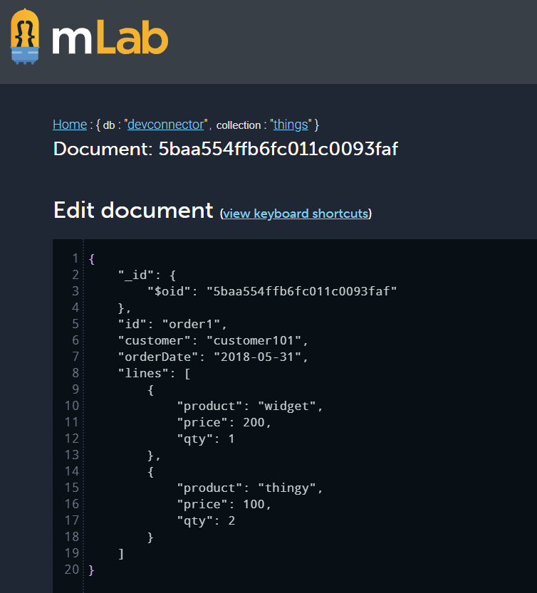
Document

Slide 7
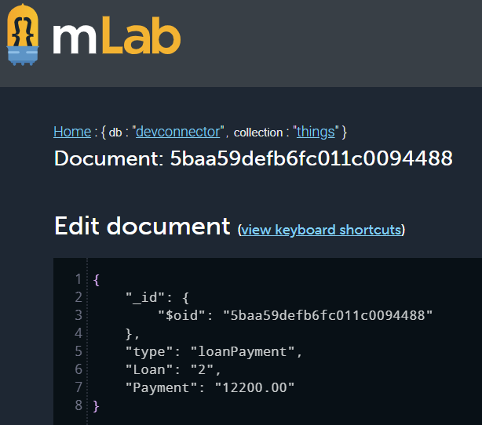
Document

Slide 8
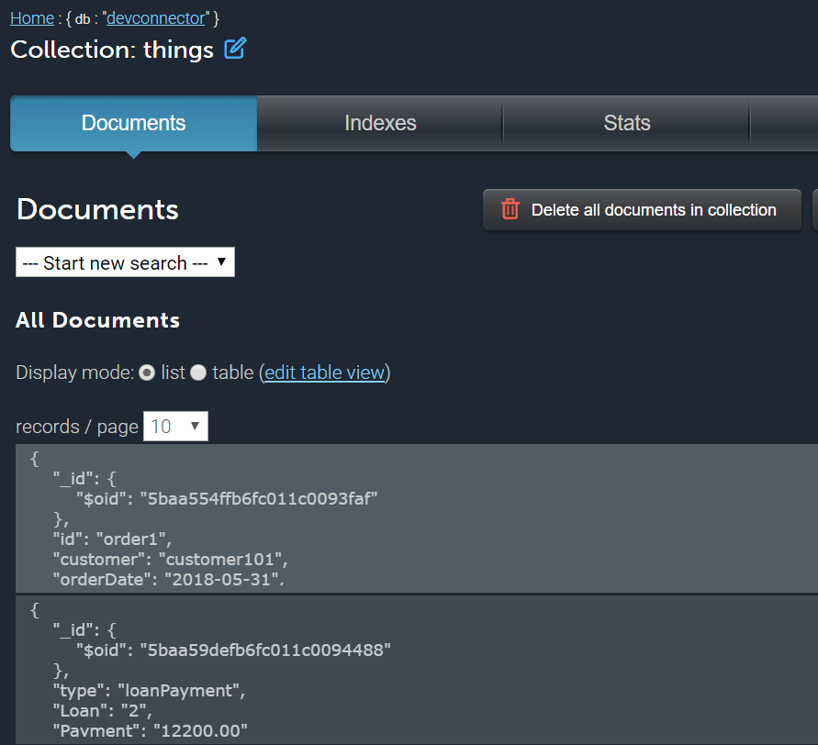
Document

Slide 9
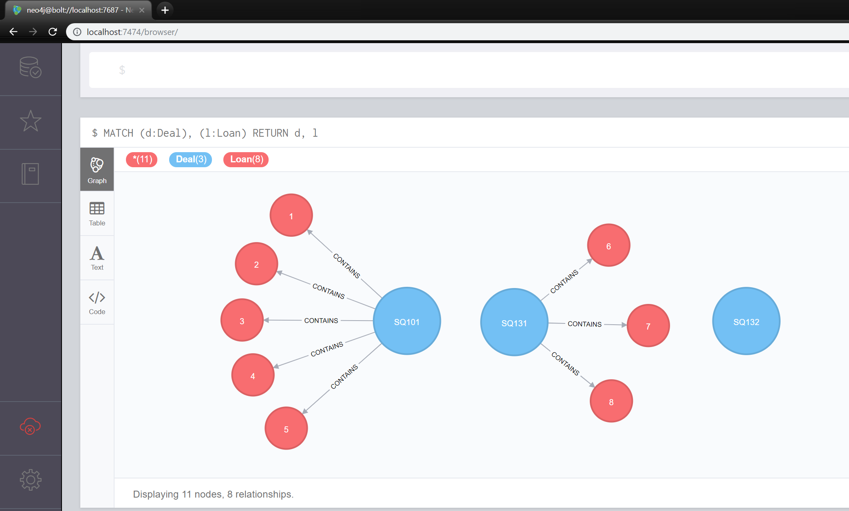
Graph Model

Slide 10
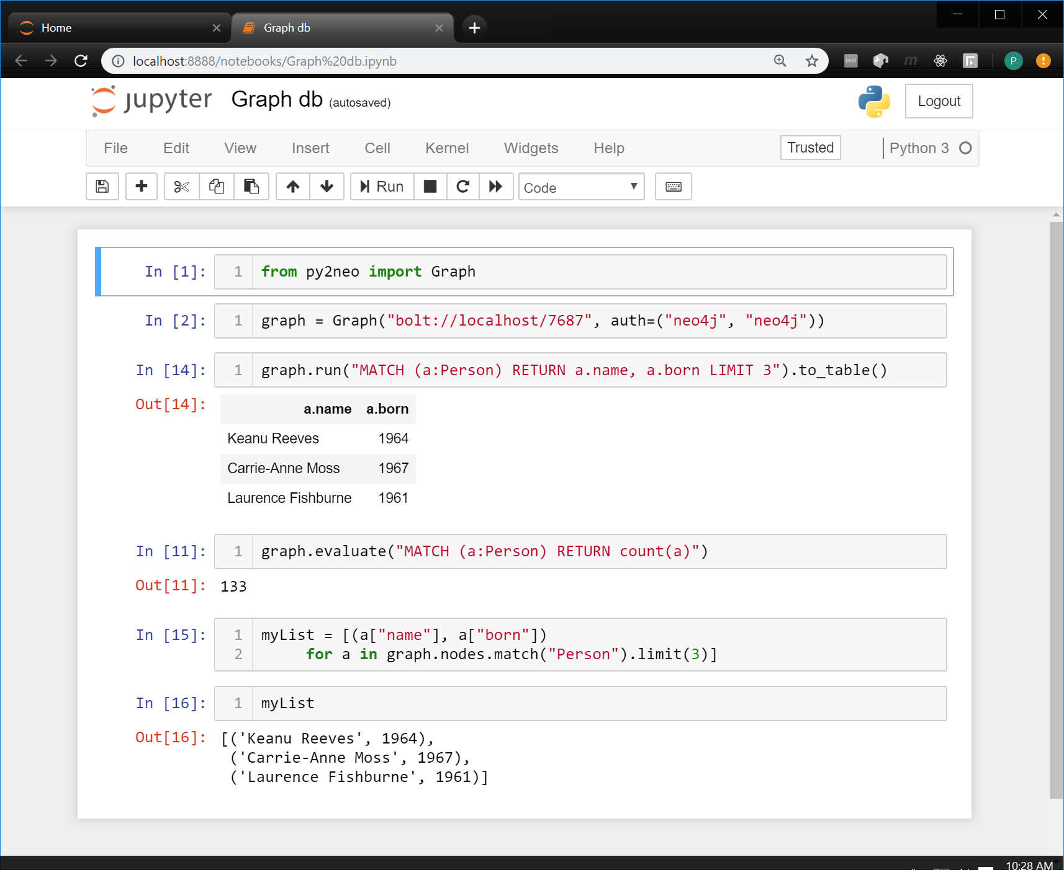
Jupyter Frontend

Slide 11
Cheat sheet
Java
jdk-10.0.1_windows-x64_bin.exe
JAVA_HOME C:\Program Files\Java\jre-10.0.1
PATH ;C:\Program Files\Java\jre-10.0.1\bin\server
Download
neo4j-community-3.4.0-windows.zip
Create Operating Folder
C:\graph
Copy in Zip contents
Start Server from CMD Run as Administrator
cd /.
cd graph/bin
neo4j console
Open Browser
localhost:7474
Username: neo4j
Password: neo4j

Slide 12
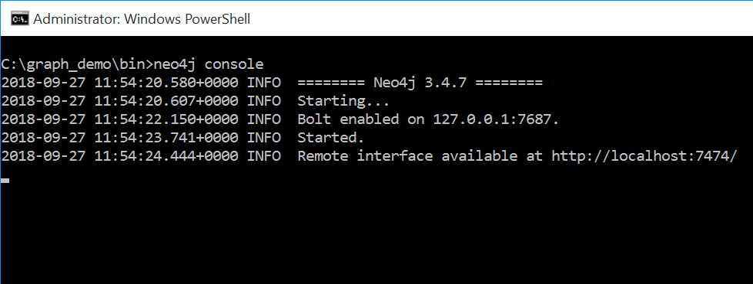
Live Demo

Slide 13
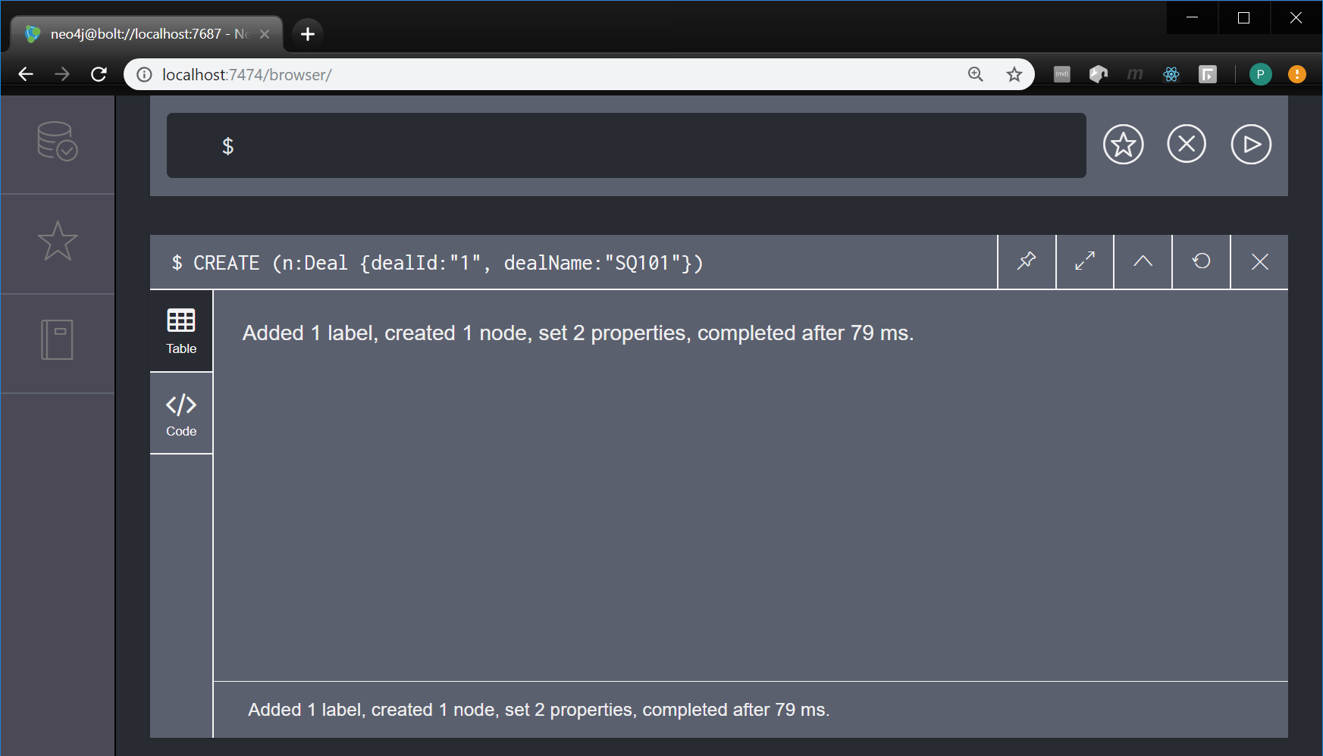
Graph Load

Slide 14
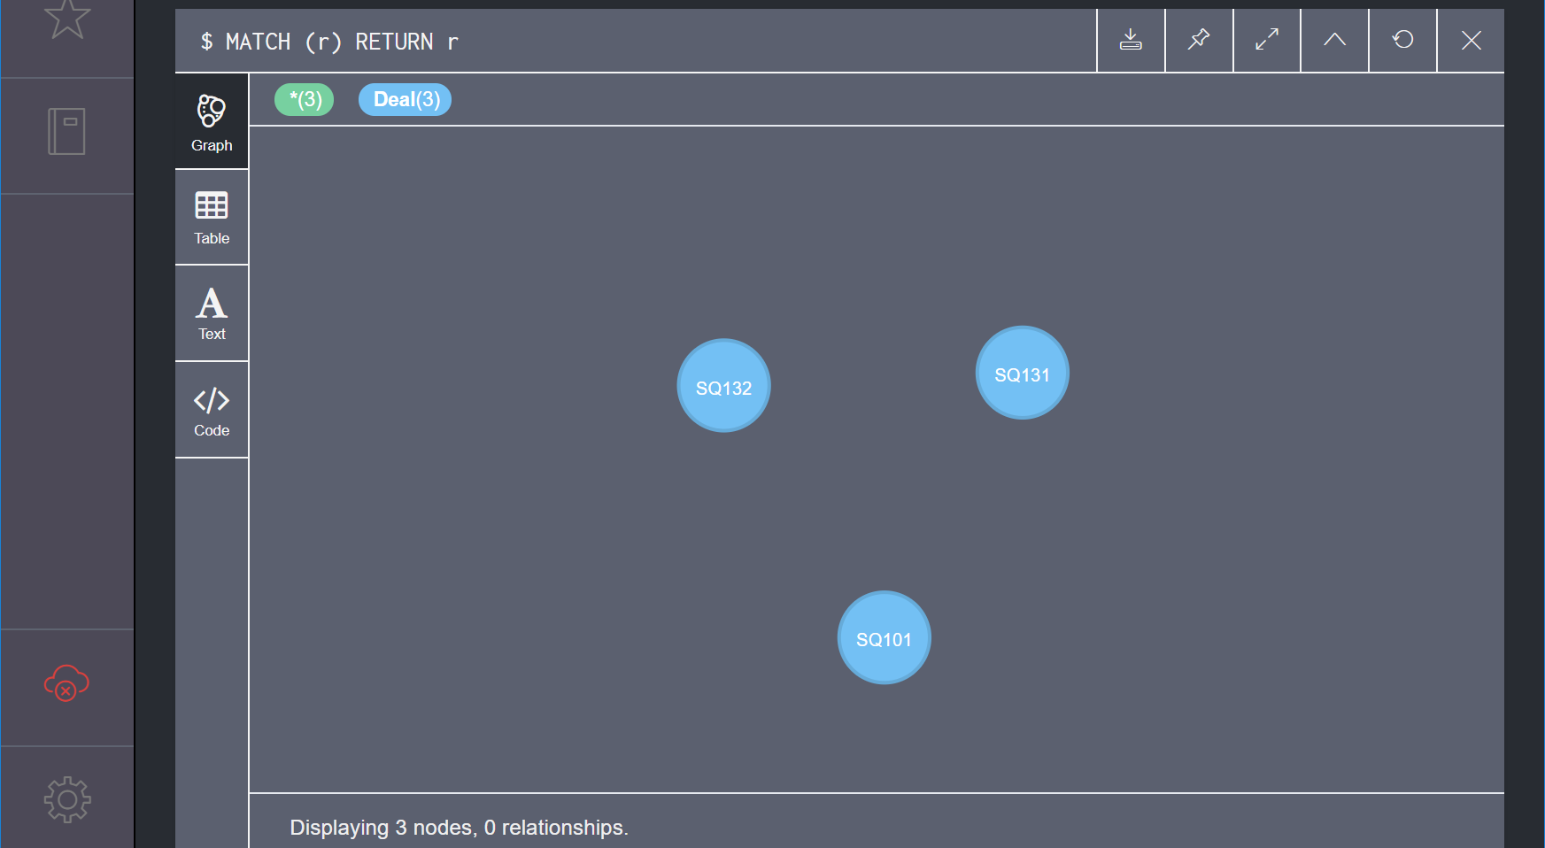
Graph Load

Slide 15
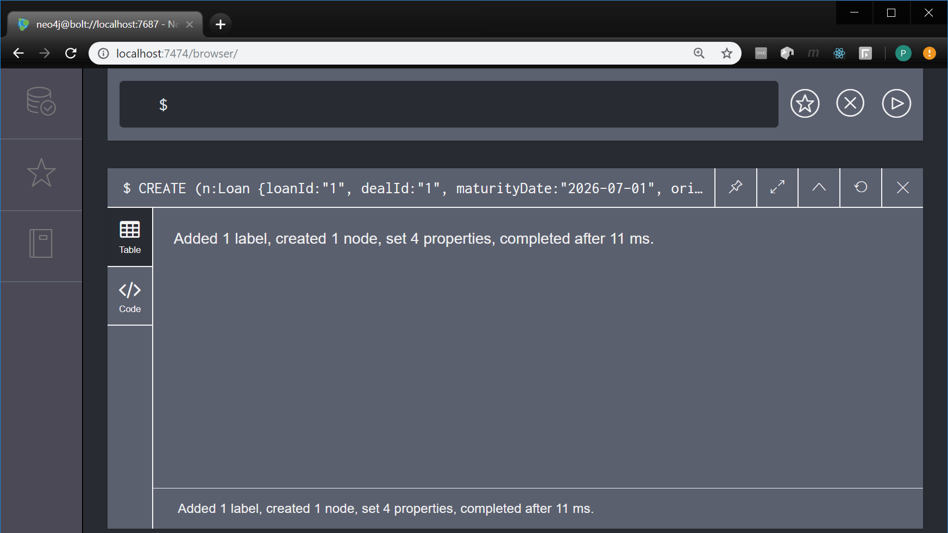
Graph Load (continued)

Slide 16
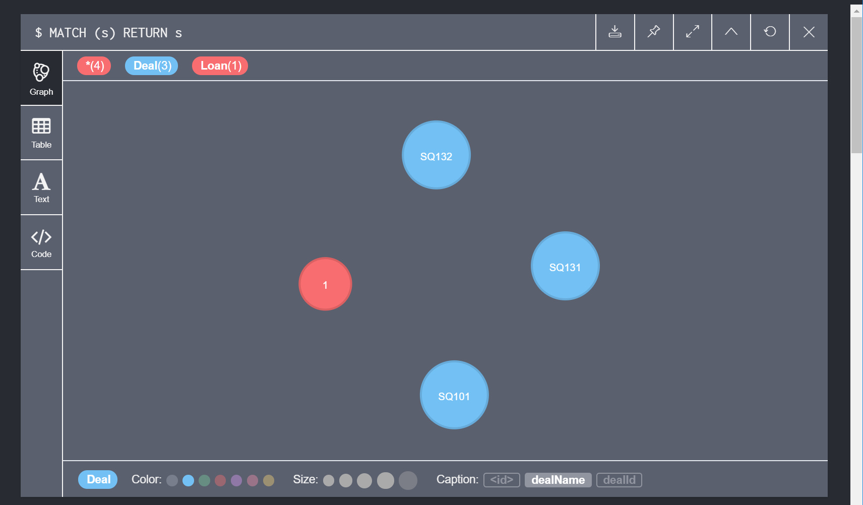
Graph Load (continued)

Slide 17
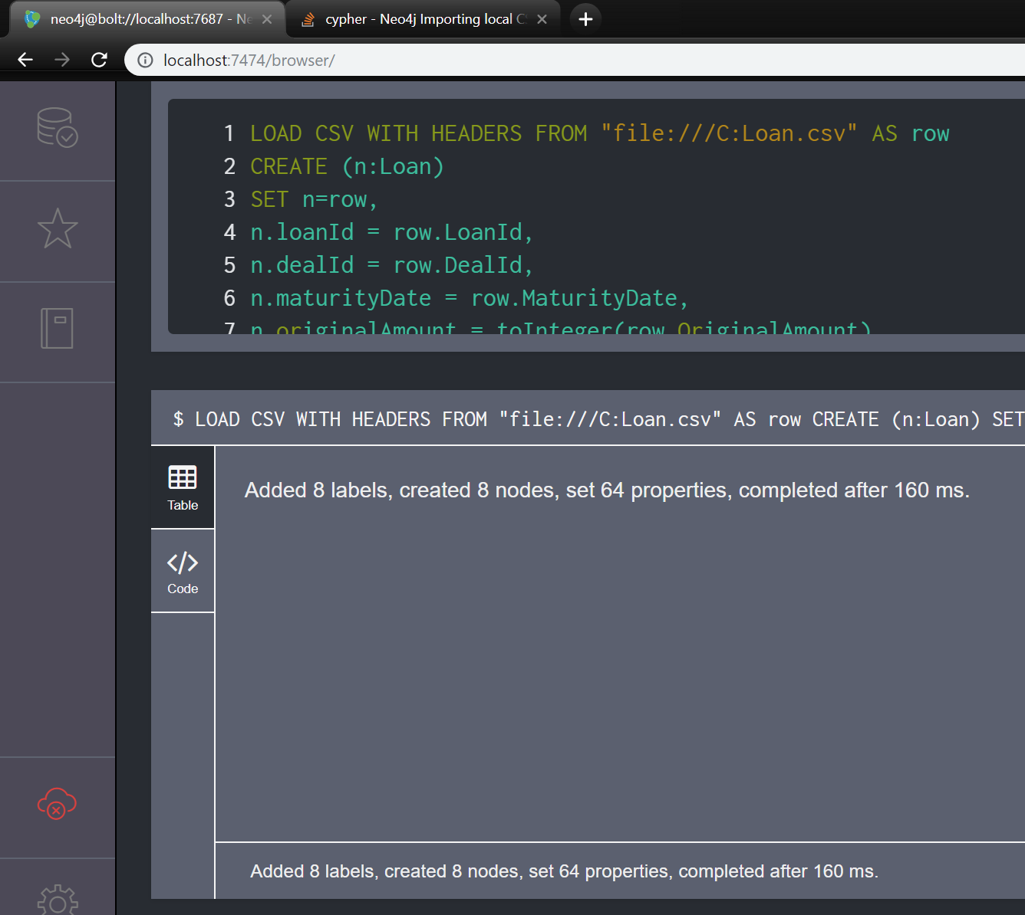
Graph Load (continued)

Slide 18
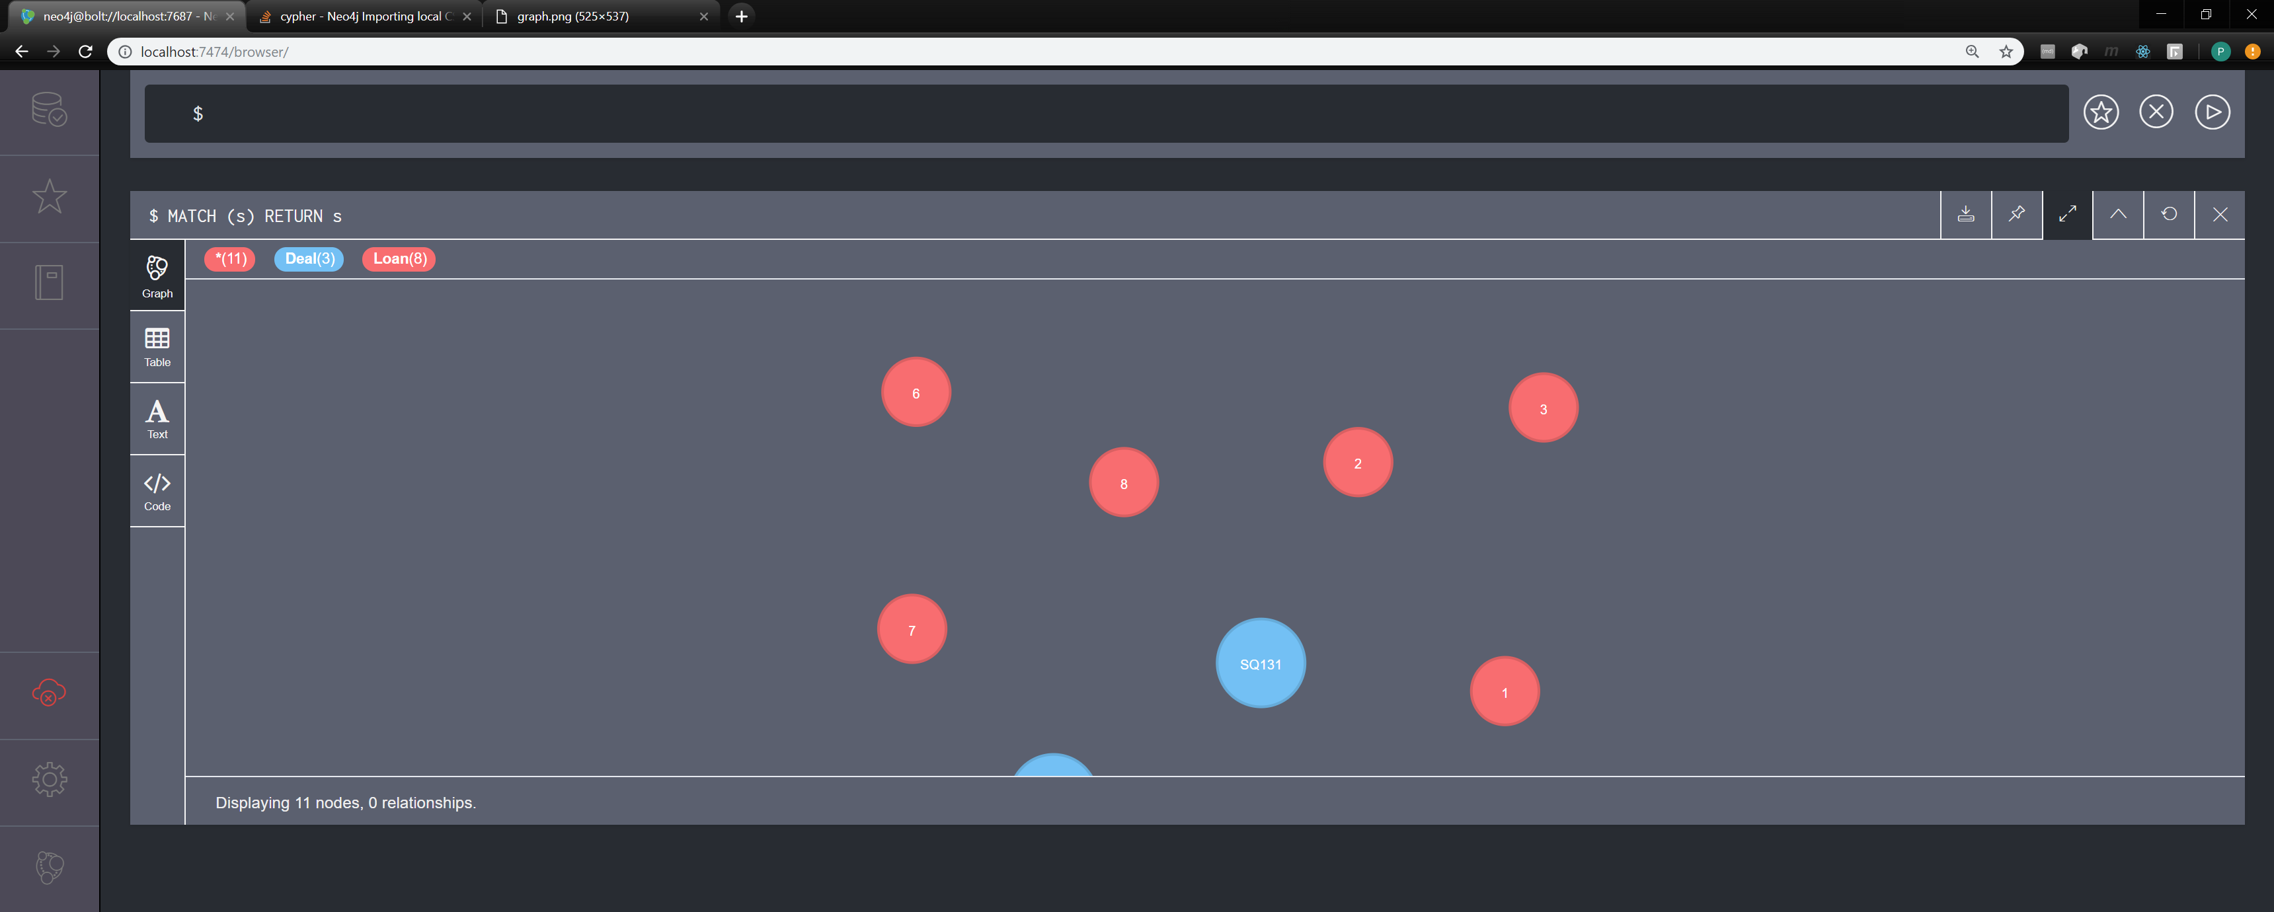
Graph Load Done

Slide 19

Graph Visualization Exported

Slide 20
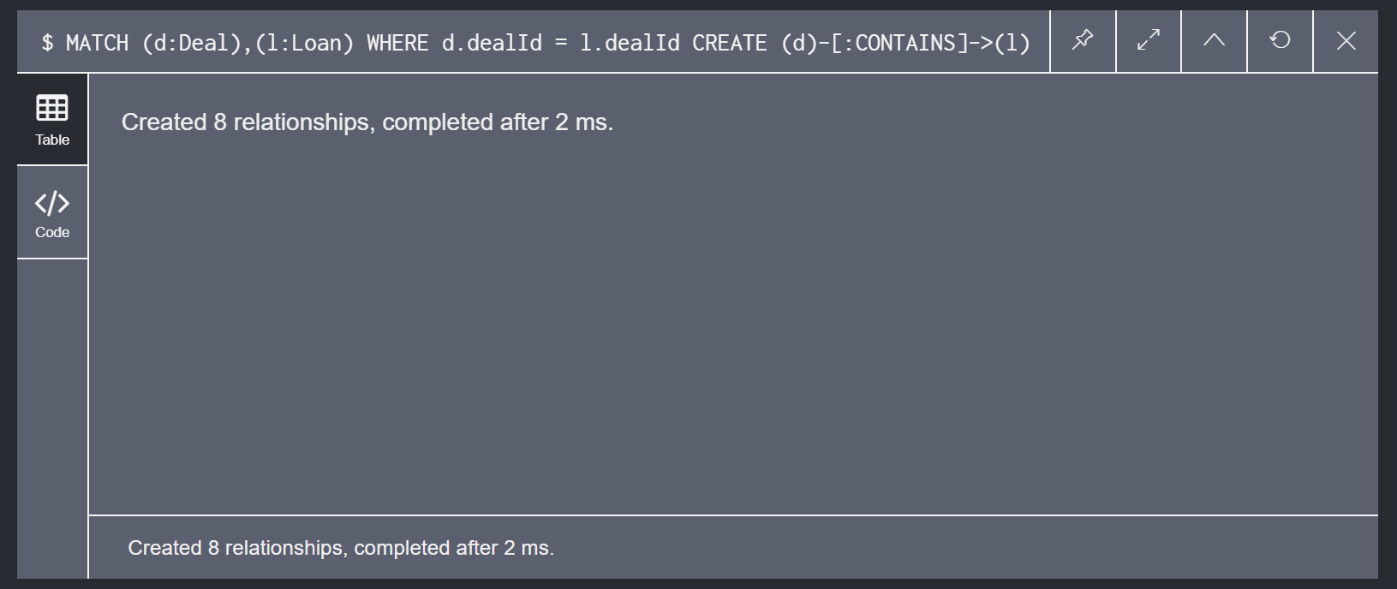
Graph Visualization

Slide 21
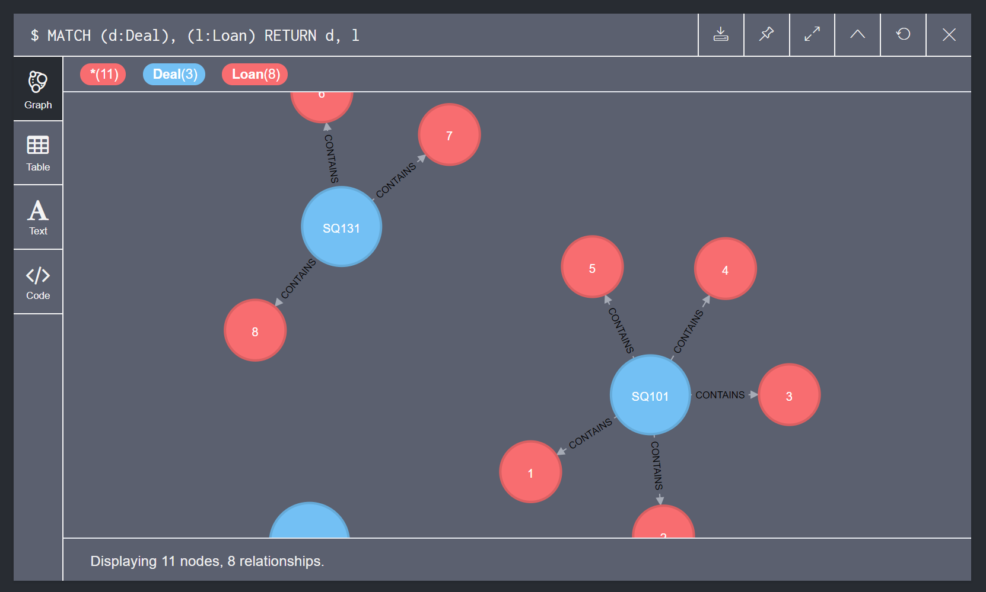
Graph Visualization

